Slide 1
Incident Management

Slide 2
Goal - Primary Objective
To restore normal service operation as quickly as possible with minimum disruption to the business, thus ensuring that the best achievable levels of availability and service are maintained

Slide 3
Why Incident Management
Ensure the best use of resource to support the business
Develop and maintain meaningful records relating to incidents
Devise and apply a consistent approach to all incidents reported
Incident Definition
An incident is an event which is not part of the standard operation of a service and which causes, or may cause an interruption to, or a reduction in the quality of that service
Notes:
Examples of Incidents:
Application – unavailable or in error
Hardware – outage or constrained use
Service Requests – for info or assistance

Slide 4
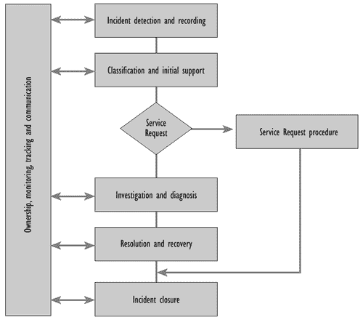
Incident Lifecycle
Notes:
Service desk plays a key role in the IM process.
Recording and Monitoring progress of an Incident and retaining ownership.
Service desk and IM have close links with SLM.

Slide 5
Impact, Urgency & Priority
IMPACT
- The likely effect the incident will have on the business (e.g. numbers affected, magnitude)
URGENCY
- Assessment of the speed with which an incident or problem requires resolution (i.e. how much delay will the resolution bear)
PRIORITY
- the relative sequence in which an incident or problem needs to be resolved, based on impact and urgency

Slide 6
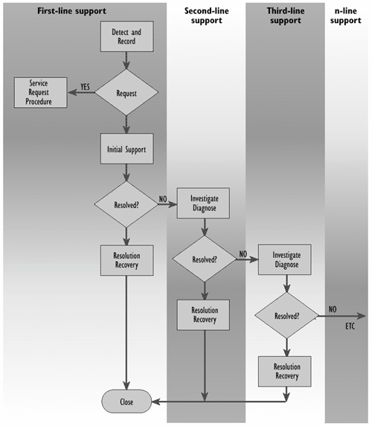
Use of Support Teams

Slide 7
Escalation
IT Service
Manager
Service Desk
Manager
2nd Line
Manager
3rd Line
Manager
Hierarchical (authority)
Service Desk
Support Team
2nd Line
Support Team
3rd Line
Support Team
Functional (competence)

Slide 8
Relationships
Relationship between incidents, Problem and Known Errors
Known Error
Structural Resolution
Incident
Error in infrastructure
Problem
RFC
Handling of Major Incidents
Major incidents occur when there is extreme impact to the Users. Problem Management should be notified to arrange a formal meeting. The Service Desk will ensure Incident records are maintained with all actions and decisions.

Slide 9
Benefits
Reduced business impact of Incidents by timely resolution
Improved monitoring of performance against targets
Elimination of lost Incidents and Service Requests
More accurate CMDB information
Improved User satisfaction
Less disruption to both IT support staff and Users

Slide 10
Possible Problems
Lack of Management commitment
Lack of agreed Customer service levels
Lack of knowledge or resources for resolving incidents
Poorly integrated processes
Unsuitable software tools
Users and IT staff bypassing the process

Slide 11
Exam Tips
IM
Restoring services is a PRIMARY objective of Incident Management
ALL calls should be logged
Incident - Problem - Known Error - Change

Slide 12
Exam Questions
Salesmen are able to use their laptops from hotels to obtain information on travel routes and travelling times. On several occasions they have found that when a certain modem had been installed, communication was unsatisfactory. A temporary solution to this fault has been identified. Which processes other than Incident Management are involved in achieving a structural solution?
A Change, Configuration, Release & Problem Management
B Only Configuration, Problem & Release Management
C Only Change & Release Management
D Only Change, Release & Configuration Management
E Only Problem & Release Management

Slide 13
Exam Questions
A trend analysis of incident data that over 30% of incidents regularly recur. Which of the following activities will contribute most to cutting down the percentage of regularly recurring incidents?
A A presentation to the board of directors to explain the importance of Problem Management
B Implementation of the Problem Management process
C The selection of an appropriate tool to log all incident data more accurately
D The introduction of a single Service Desk number so customers know who to contact

Slide 14
Exam Questions
Which of the following data is least likely to be used in the incident control process?
A Incident category
B Make/model of faulty item
C Impact code
D Cost of faulty item

Slide 15
Exam Questions
If a customer complains that service levels are below those agreed in the SLA, apparently due to a number of related hardware incidents, who is responsible for ensuring the cause is investigated?
A The Incident Manager
B The Capacity Manager
C The Problem Manager
D The Availability Manager

